Slide 1

Databases
Can explain the basic concepts of databases

Slide 2
Basic Definitions
Data Facts that can be recorded and have an implicit meaning.
E.g. “John B. Smith” a name, 123456789 a ssn ---two pieces of data
Database A collection of related data.

Slide 3
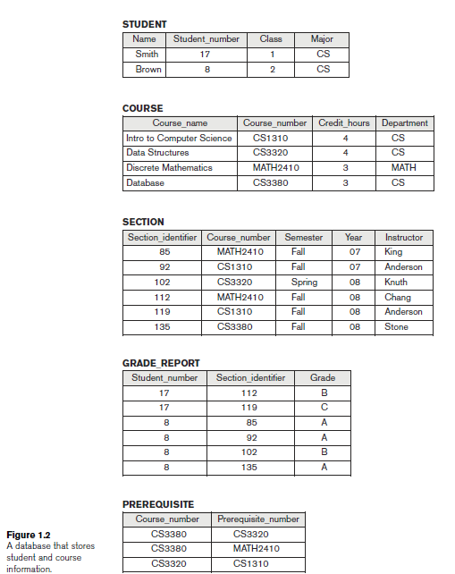
Sample DB
Concepts:
Tables
Columns
Rows
Primary keys
Foreign keys

Slide 4
Typical DBMS Functionality
Define a database : in terms of data types, structures and constraints
Manipulating the database : querying, generating reports, insertions, deletions and modifications to its content
Concurrent Processing and Sharing by a set of users and programs – yet, keeping all data valid and consistent
Prevent unauthorized access

Slide 5
User/programmers
Database
System
Application programs/
Queries from SQL Management Tool
DBMS
Software
Software to process queries/programs
Software to access stored data
Stored database definition
Meta data
Stored
database

Slide 6
Main Characteristics of the Database Approach
Self-describing nature of a database system: A DBMS catalog stores the description of the database. The description is called meta-data). This allows the DBMS software to work with different databases.
Insulation between programs and data: Called program-data independence. Allows changing data storage structures and operations without having to change the DBMS access programs.

Slide 7
Main Characteristics of the Database Approach
Data Abstraction: A data model is used to hide storage details and present the users with a conceptual view of the database.
Support of multiple views of the data: Each user may see a different view of the database, which describes only the data of interest to that user.

Slide 8
Main Characteristics of the Database Approach
Sharing of data and multiuser transaction processing : Allowing a set of concurrent users to retrieve and to update the database. Concurrency control within the DBMS guarantees that each transaction is correctly executed or completely aborted.

Slide 9
Relational Databases: Pros and Cons
Pros:
Existed for a long time
Based on a solid theoretical model
Many good and well tested tools
Experience-proven technology
Good performance
Handles consistency well (no redundancy)
Transactions supported
Flexible queries
Handles many to may relations well
Cons:
Doesn’t scale well for very large data sets (“Big Data”)
Rigid data structure

